Slide 1



Slide 2

Public Health Week 1-Introductory slide

Slide 3
Module Aims:
This Public Health module will develop a knowledge of the main issues and skills needed to explore the burden of disease and ill health.
Students will acquire a critical.
Understanding of the principles, methods and theoretical approaches to the promotion of health and the prevention of ill-health, and the planning and evaluation of health promotion programmes.
The module will allow the exploration of some of the main issues and skills needed to appreciate issues around poverty and social exclusion, whilst been able to relate learning to the development, planning and evaluating of health promotion interventions and programmes in response to health promotion issues in students’ professional roles or working lives.

Slide 4
Public health is rapidly becoming one of the most recognised areas to focus attention on in terms of improving health and quality of life of populations.
This Public Health module will explore topics about preventing disease, prolonging life and promoting health through the efforts of society.
This module will explore identified contemporary issues facing population health, develop skills in assessing health needs and priority setting and understand the theory and evidence of promoting public health, whilst recognising the underlying principles behind inequalities in health and the exploration of current health promotion approaches to reduce these inequalities.

Slide 5


This Public Health module will develop a further understanding of evidence explored in the Exploration of Health Conditions module at level 4.
It will develop the holistic idea of health that have been identified within that module and how the role of public health can prevent or reduce these concerns.
The module will also link to the Contemporary Issues module allowing students to explore the epidemiology around these issues and will build on learning from Psychological and Social Science, whilst considering the importance of collaborative working between the sectors, including health and social care, to promote public health.

Slide 6
The opportunity to explore public health issues, the association between the social determinants and health the strategies that have been employed to reduce these issues; whilst applying knowledge and understanding from the supporting modules will allow a deeper understanding of both sectors role in working together to reduce the health and social inequalities that continue to exist today.
Public health is defined as the science of protecting the safety and improving the health of communities through education, policy making and research for disease and illness prevention (PHE 2016).

Slide 7
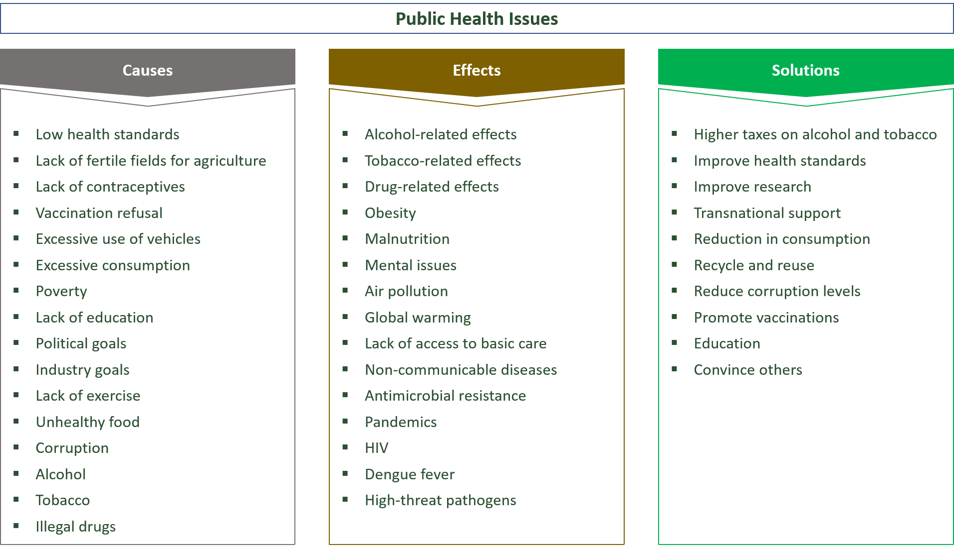

Slide 8
Module Learning Outcomes:
LO1. Develop an understanding of disease and ill-health and the underlying principles behind inequalities in health.
LO2. Analyse a range of strategies to promote and enhance health.
LO3. Analyse the role of epidemiology and demographics in relation to public health practice.
LO4. Evaluate theories and approaches of health promotions relevant to health issues within professional roles or work placement.

Slide 9
Teaching and Learning Strategy
Formal lecture based delivery will be used to establish an understanding of public health and build upon the foundations of previous modules and associated content
A key focus on student is carrying out directed research into contemporary public health issues, to which they will share their findings with fellow students will transpire. These seminars will lead into the opportunity for structured discussion and debates to be instigated
Furthermore it will allow students to develop transferable skills in confidence in preparation for summative assessment of a health promotion campaign.
Students will be expected to support their learning by researching media reports, government policies and relevant supporting findings unique to own sector.
Individual and group tutorial activities will be used to assist students in their reading and interpretation concepts and to provide feedback on all aspects of their progress.

Slide 10
Learning Opportunities
Students will have a variety of learning experiences. With a key focus on independent study to allow for critical thinking skills to be developed.
Opportunity to share and discuss finding with peers and debate context will be a unique feature to this module.
Students will also have the opportunity to access tutorial support to discuss the progress of their work on a group or individual basis.

Slide 11
The assessment for Public Health has one component part
Task 1: Produce a health promotion campaign and an evaluative report which;
The content should cover the following learning outcomes:
LO1- Develops an understanding of disease and ill-health and the underlying principles behind inequalities in health.
LO2- Analyses a range of strategies to promote and enhance health.
LO3- Analyses the role of epidemiology and demographics in relation to public health practice.
LO4- Evaluates theories and approaches of health promotions relevant to health issues within professional roles or work placement.

Slide 12
You are required to do the following
Task 1: Produce a health promotion campaign and an evaluative report which;
Develops an understanding of disease and ill-health and the underlying principles behind inequalities in health.
Analyses a range of strategies to promote and enhance health.
Analyses the role of epidemiology and demographics in relation to public health practice.
Evaluates theories and approaches of health promotions relevant to health issues within professional roles or work placement.
(Equivalent to 2500 words)
Submit your file either in Word or PDF.
Online submission will take place on Turnitin.

